Slide 1
APNA BHARAT
BUS BOOKING RESERVATION SYSTEM
TECH STACK USED : PYTHON, SQLITE & TKINTER

Slide 2
TABLE OF CONTENTS
01
03
02
04
HOME SECTION
CHECK BOOKED SEAT SECTION
SEAT BOOKING SECTION
ADD BUS DETAILS SECTION

Slide 3
HOME SECTION
01
The Home Section links all the sections of the application : Seat Booking, Check Booked Seat and Add Bus Details Sections.

Slide 4
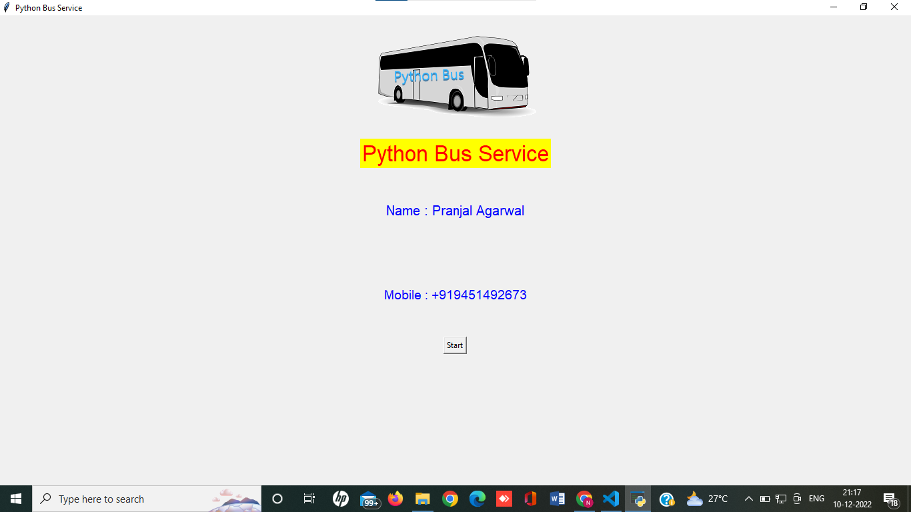
START PAGE

Slide 5
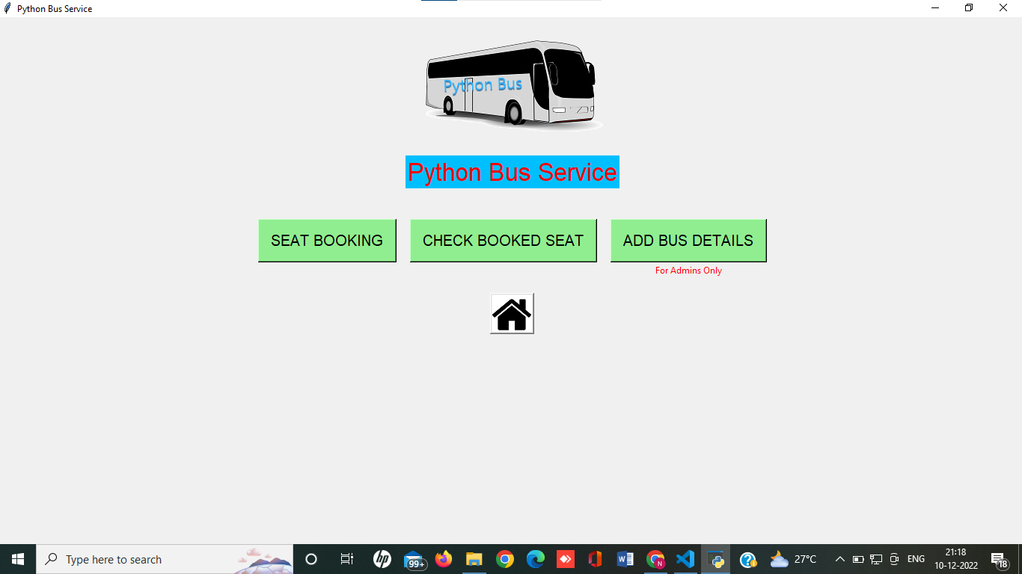
HOME PAGE

Slide 6
SEAT BOOKING SECTION
02
We can enter journey details to check bus availability. After we proceed to book, we can select our bus, enter passenger details and book our ticket.

Slide 7
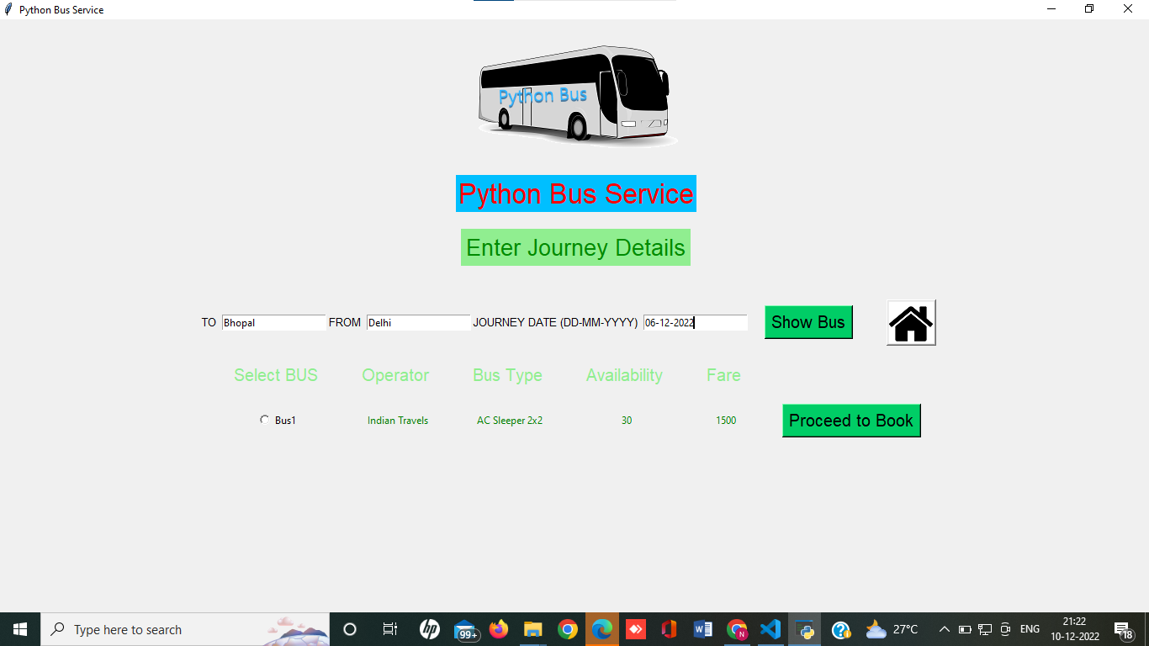
SEAT BOOKING PAGE
Enter Journey Details to View Available Buses
Select Bus to Book

Slide 8
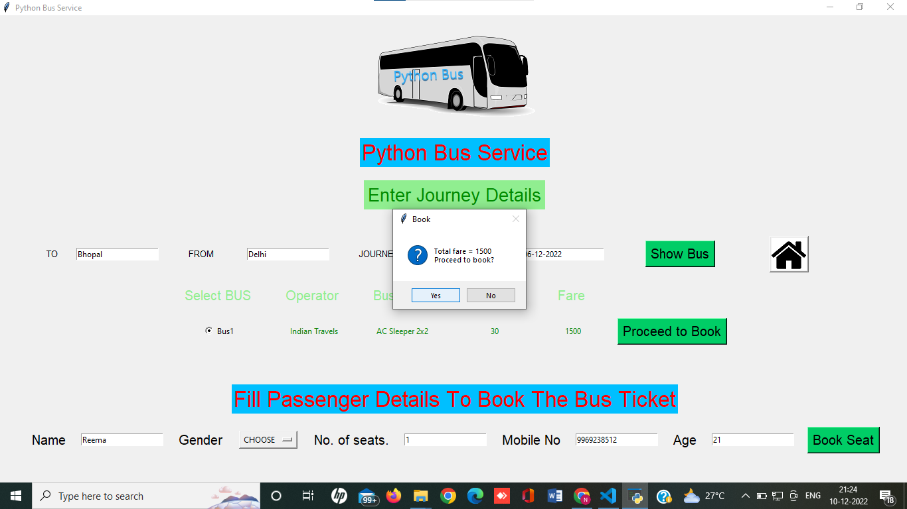
SEAT BOOKING PAGE
Enter Passenger Details and Confirm Booking

Slide 9
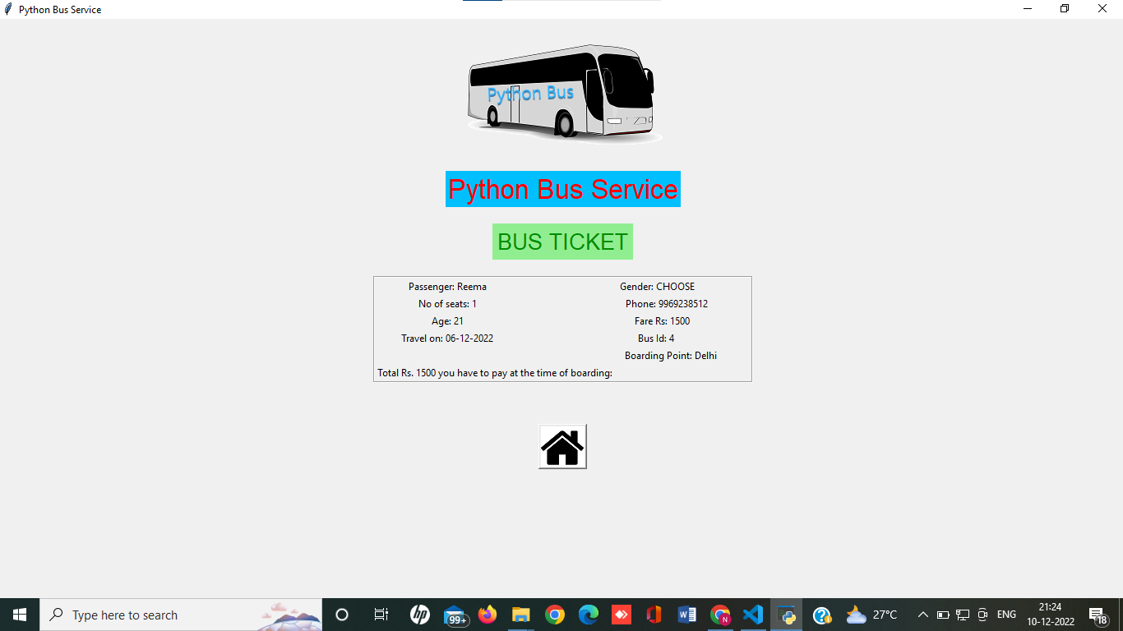
SEAT BOOKING PAGE
View Bus Ticket Details

Slide 10
CHECK BOOKED SEAT SECTION
03
We can enter our mobile number to view and confirm our ticket booking details.

Slide 11
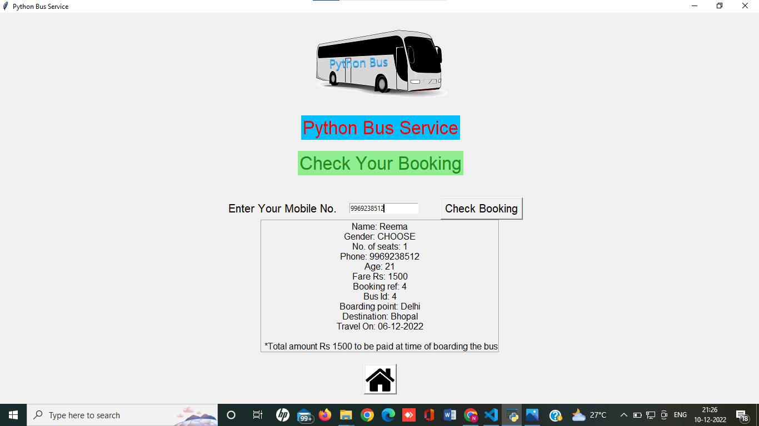
CHECK BOOKED SEAT PAGE
Enter Mobile No. to Check Seat Booking

Slide 12
ADD BUS DETAILS SECTION
04
Admins can add and delete bus operator details, bus type and bus route details along with bus run details.

Slide 13
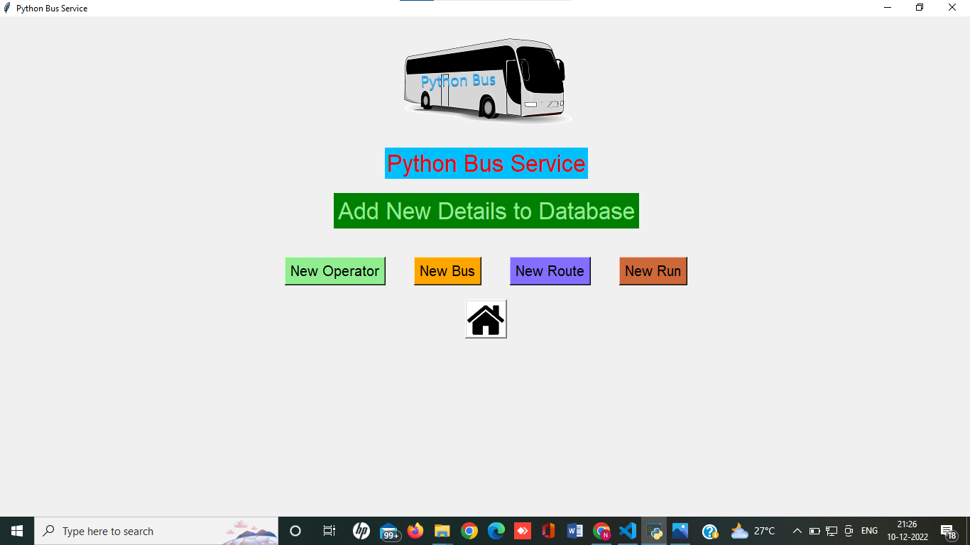
ADD BUS DETAILS PAGE

Slide 14
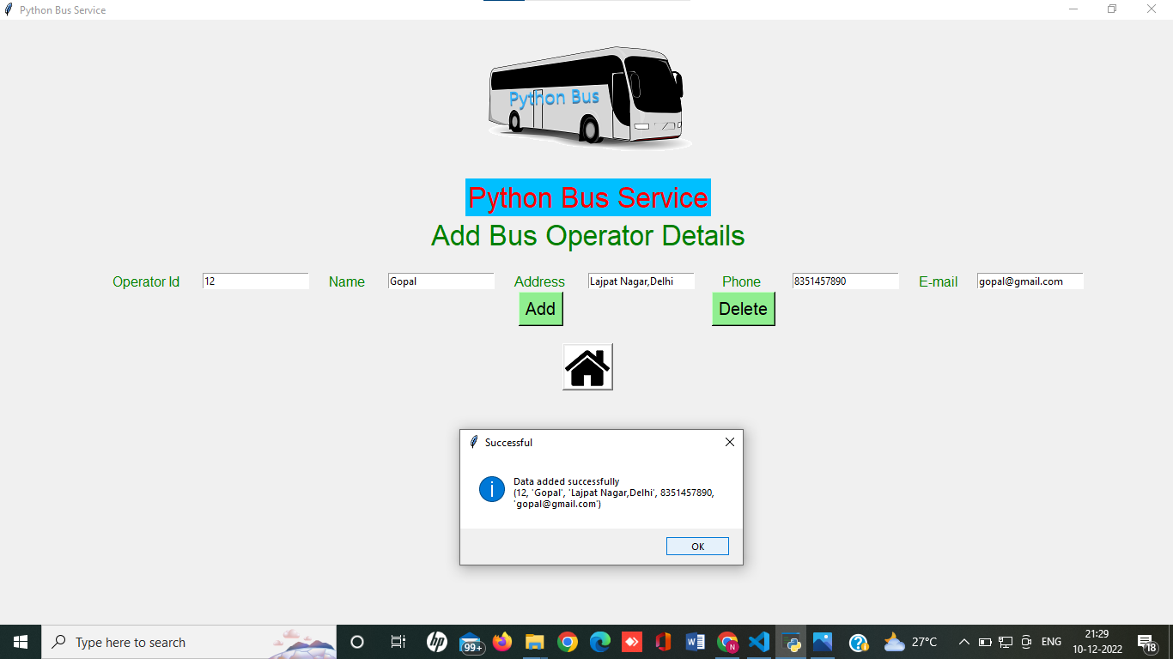
BUS OPERTOR PAGE
Enter Bus Operator Details and Click on Add to Enter

Slide 15
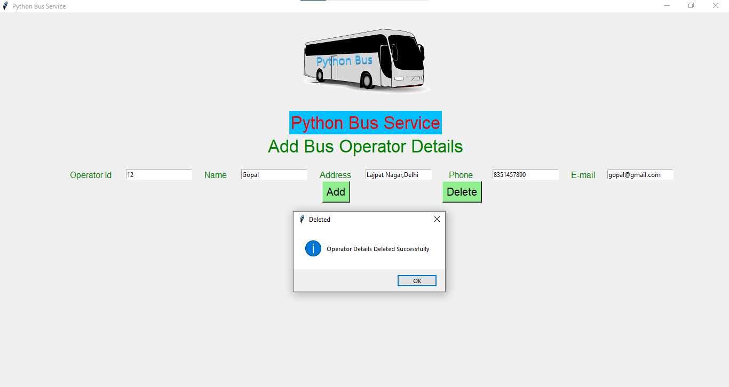
BUS OPERTOR PAGE
Enter Bus Operator Details and Click on Delete to Remove

Slide 16
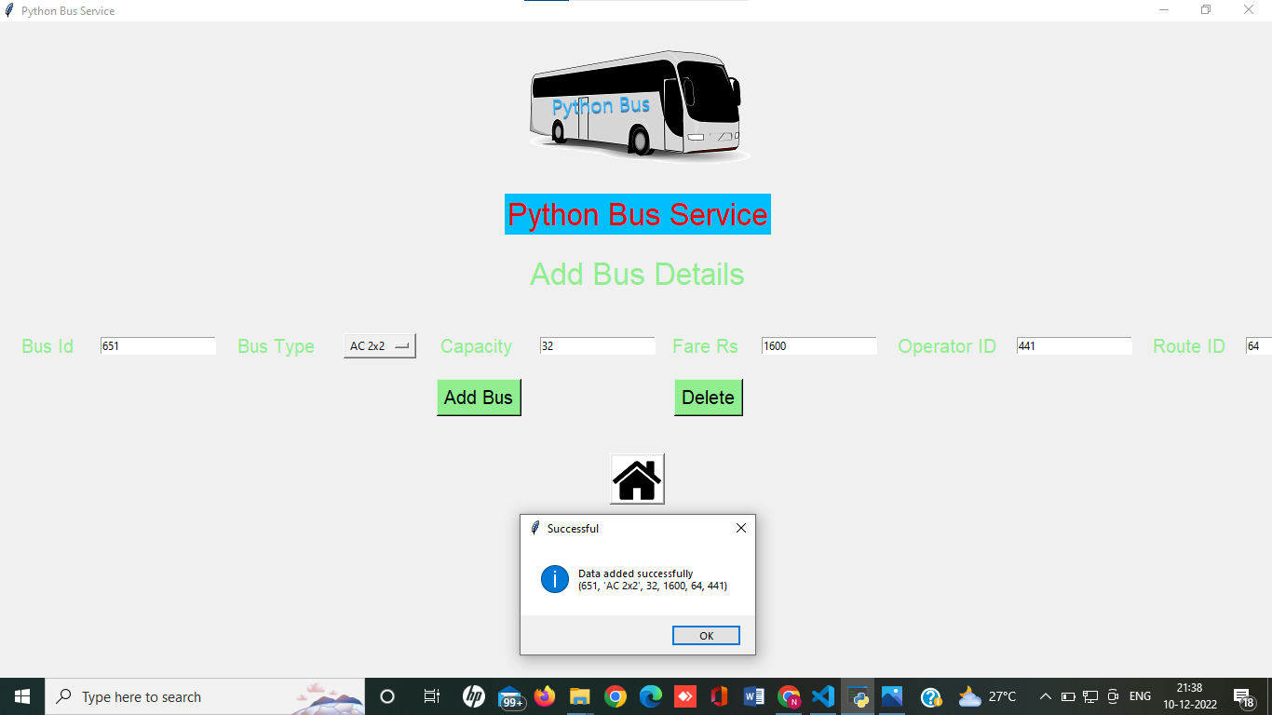
BUS DETAILS PAGE
Enter Bus Details and Click on Add to Enter

Slide 17

BUS DETAILS PAGE
Enter Bus Details and Click on Delete to Remove

Slide 18
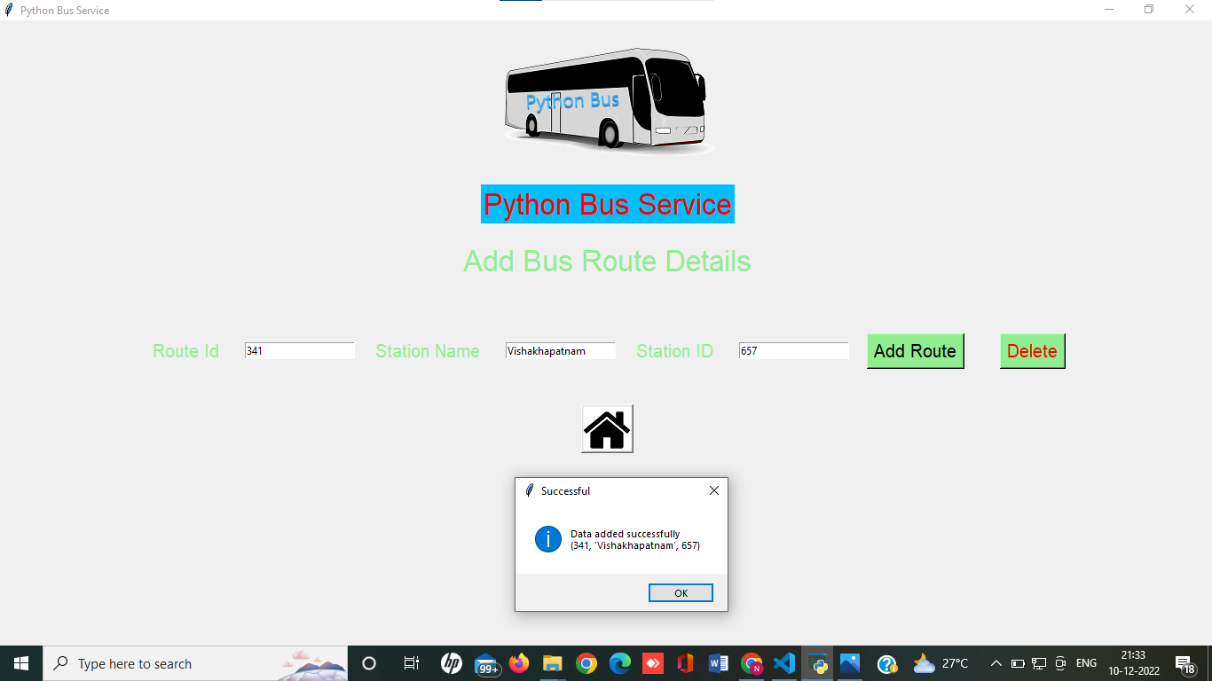
BUS ROUTE PAGE
Enter Bus Route Details and Click on Add to Enter

Slide 19

BUS ROUTE PAGE
Enter Bus Route Details and Click on Delete to Remove

Slide 20
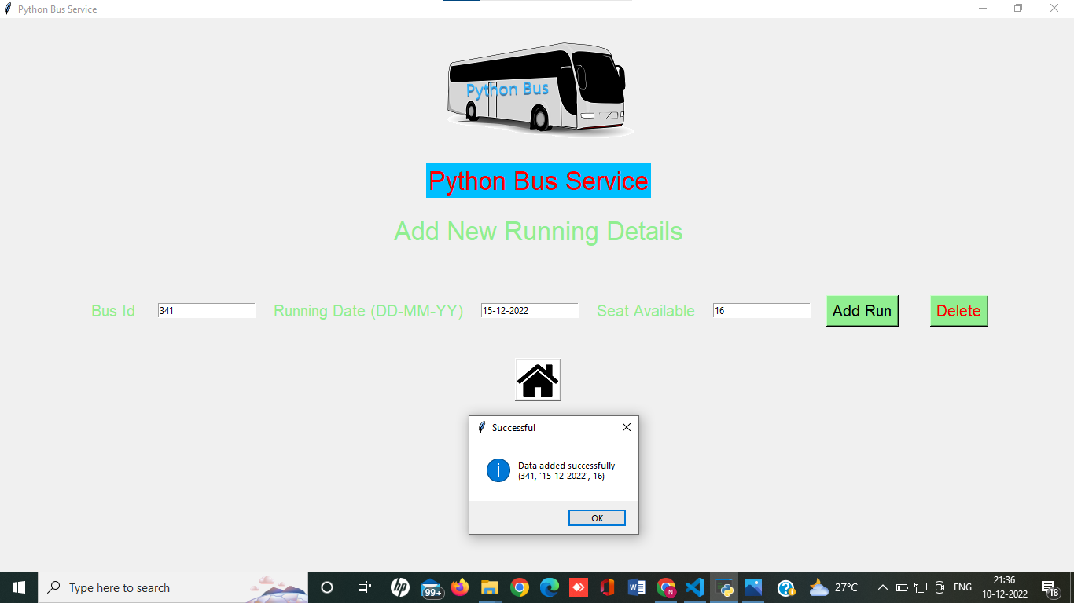
BUS RUNNING PAGE
Enter Running Details and Click on Add to Enter

Slide 21

BUS RUNNING PAGE
Enter Running Details and Click on Delete to Remove

Slide 22
THANK YOU !

